Slide 1
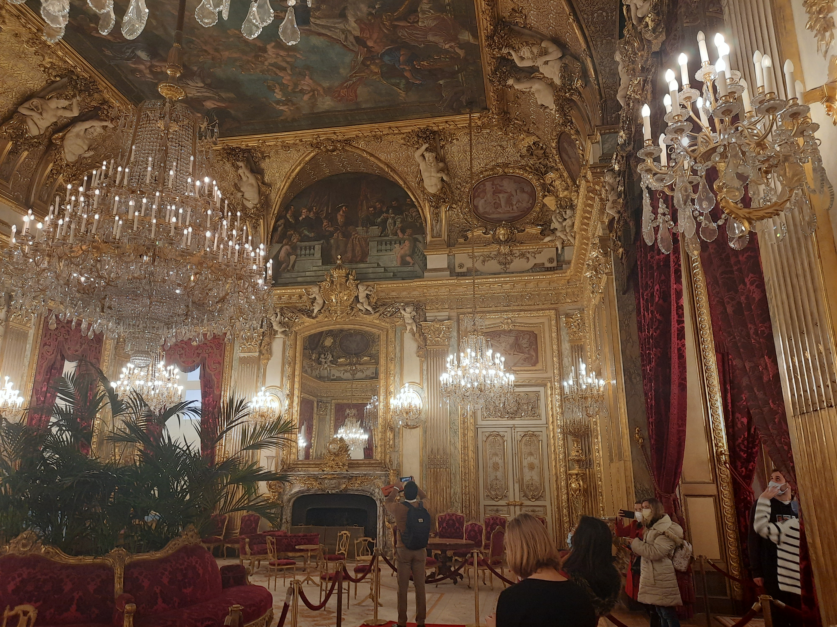
COS 457 Final Project
MUSEUM PROJECT – ZACK MATEY

Slide 2
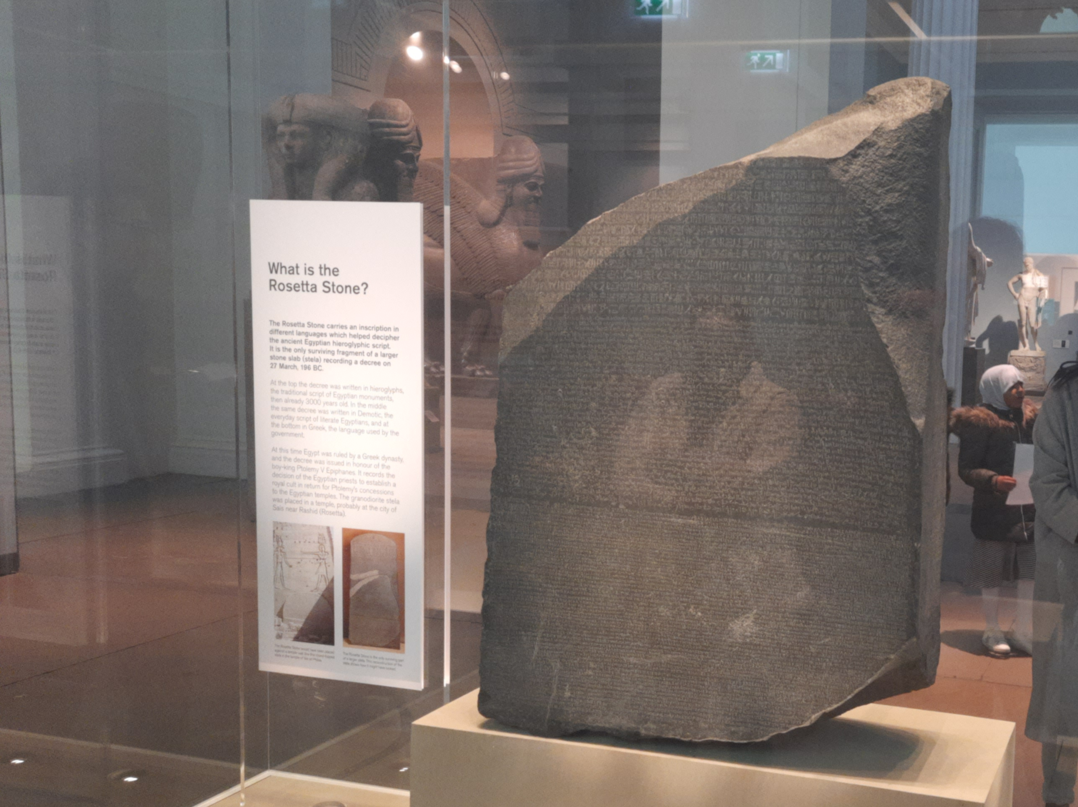

Scenario
Museum Management System

Slide 3
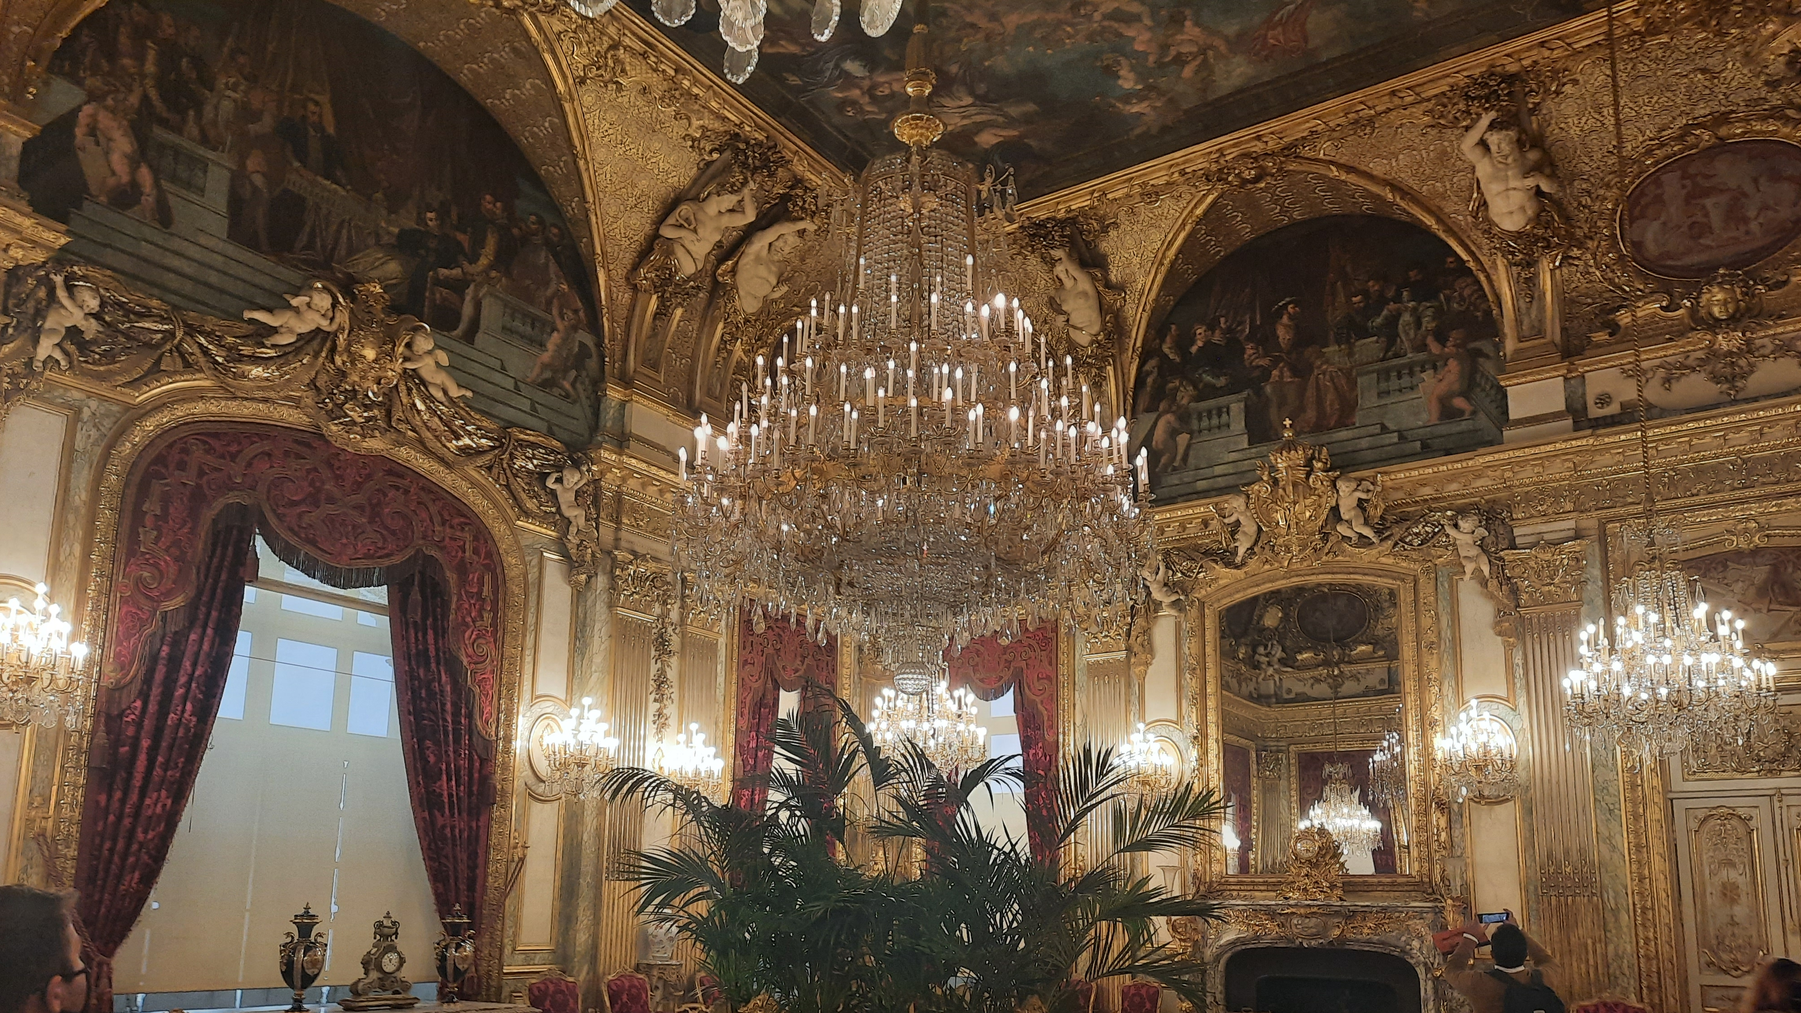
Conceptual Design
MUSEUM MANAGEMENT SYSTEM

Slide 4
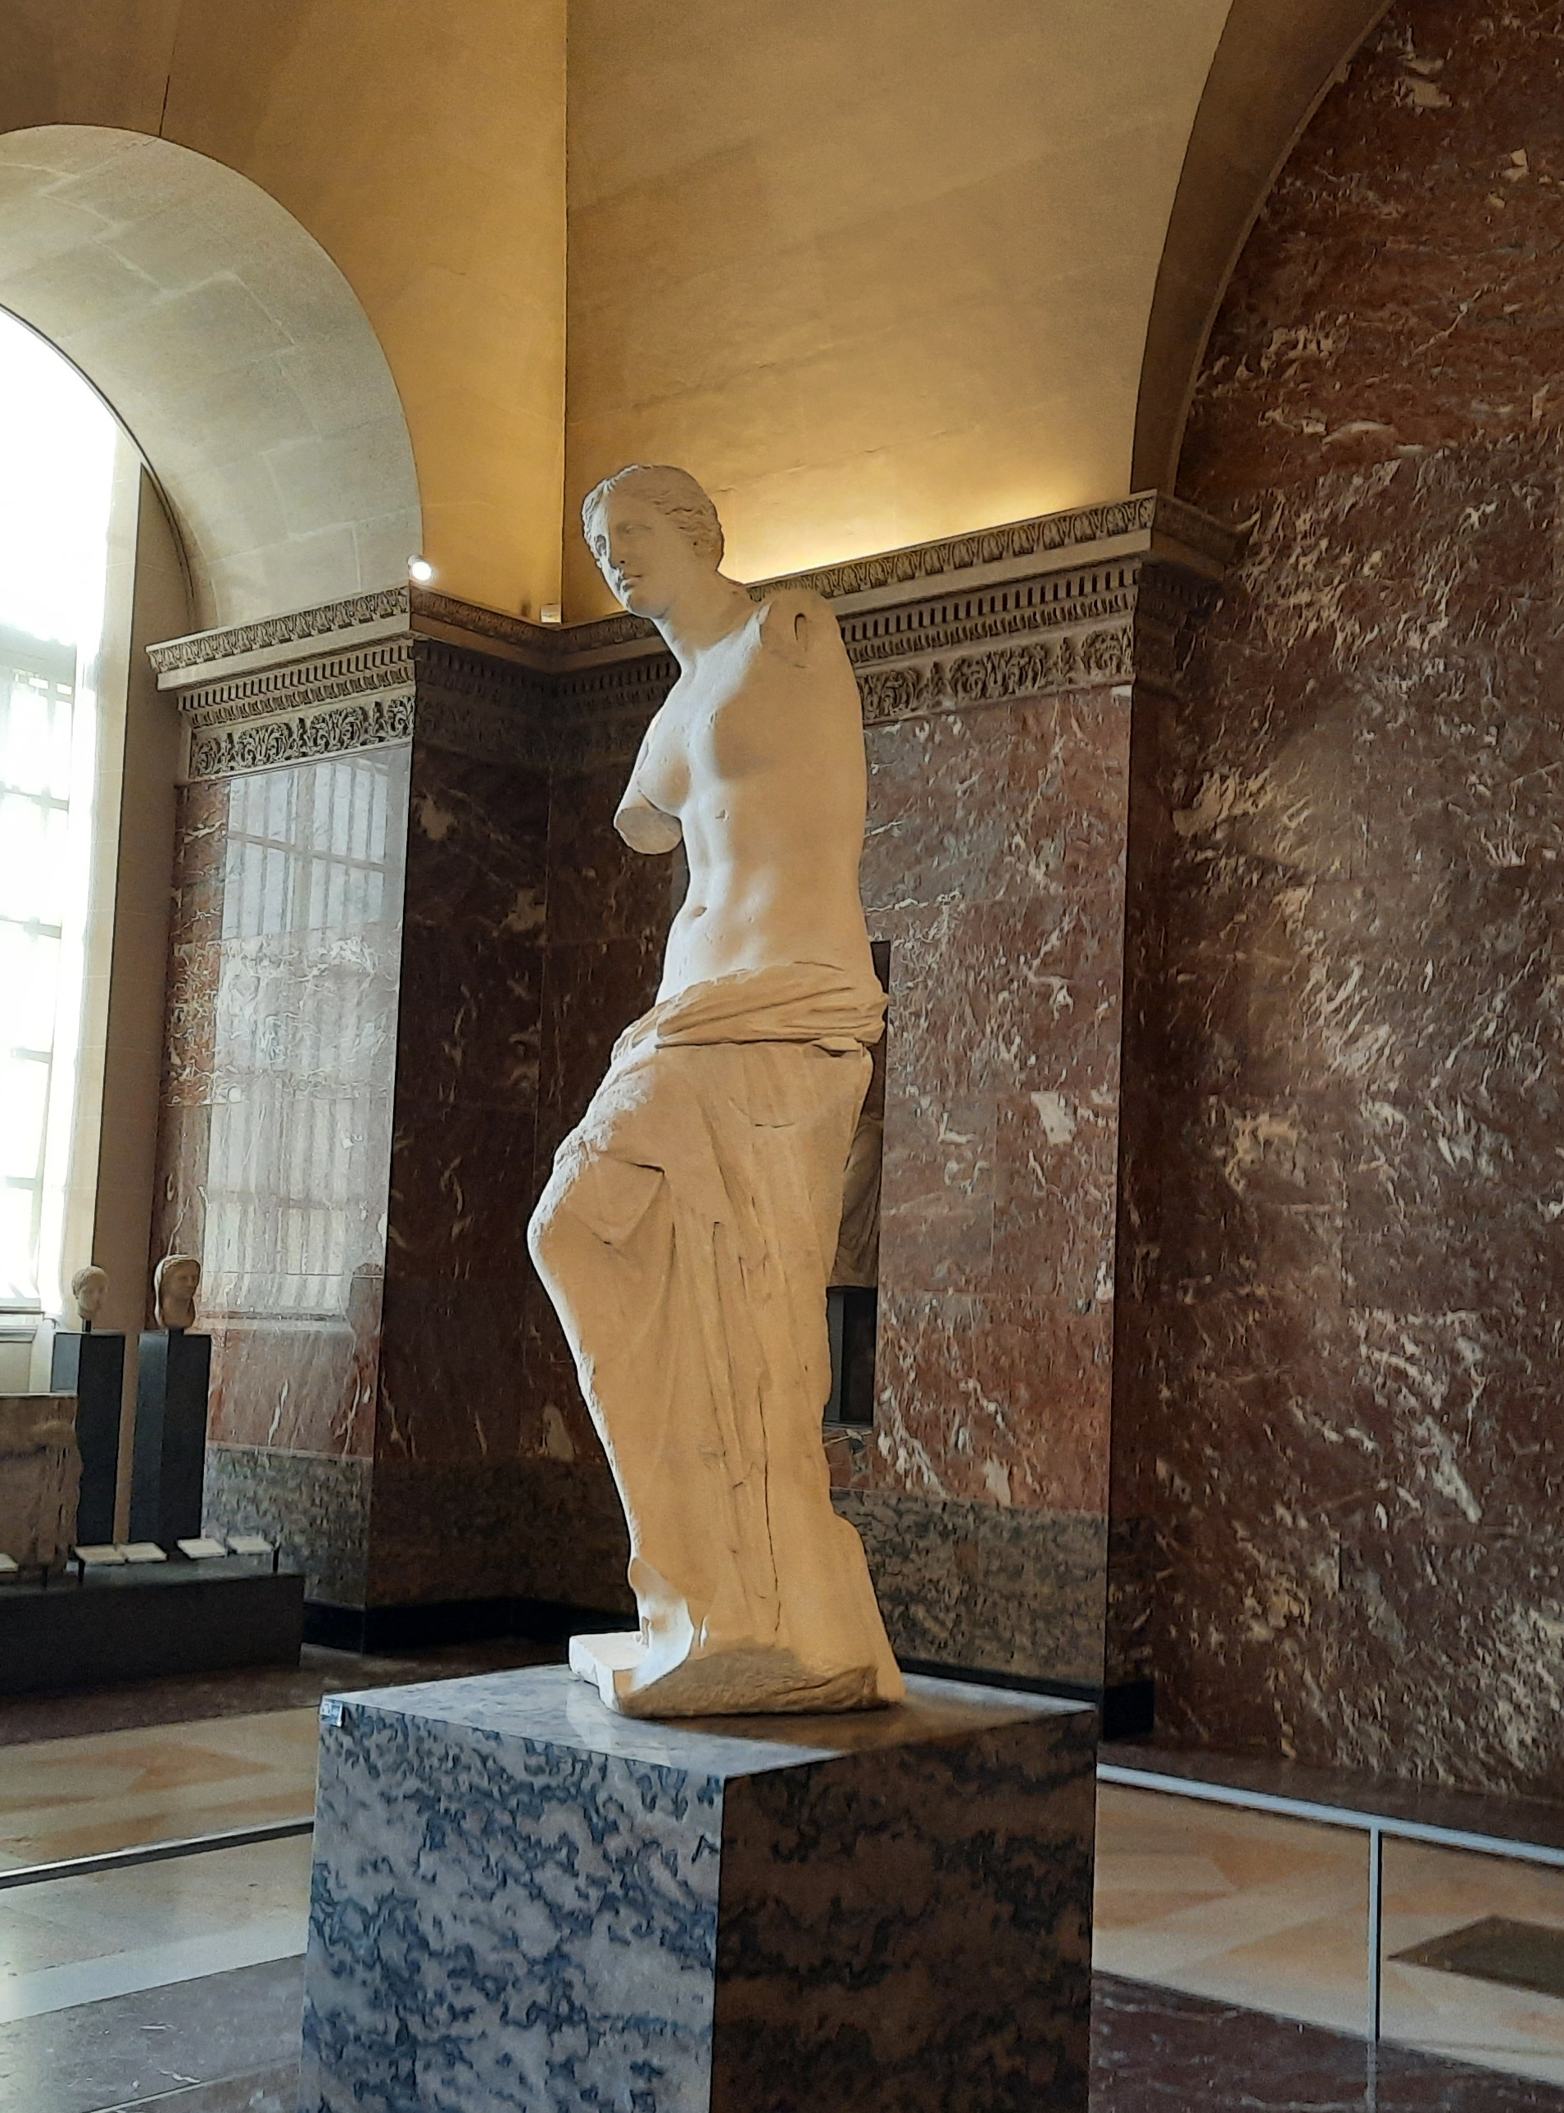
Conceptual design: Challenges
Due to the potential level of complexity of this system, managing scope became one of the more challenging aspects of this conceptual design. I moved through multiple iterations of conceptual design with different scopes before deciding on what I thought would be a scope for the project.

Slide 5
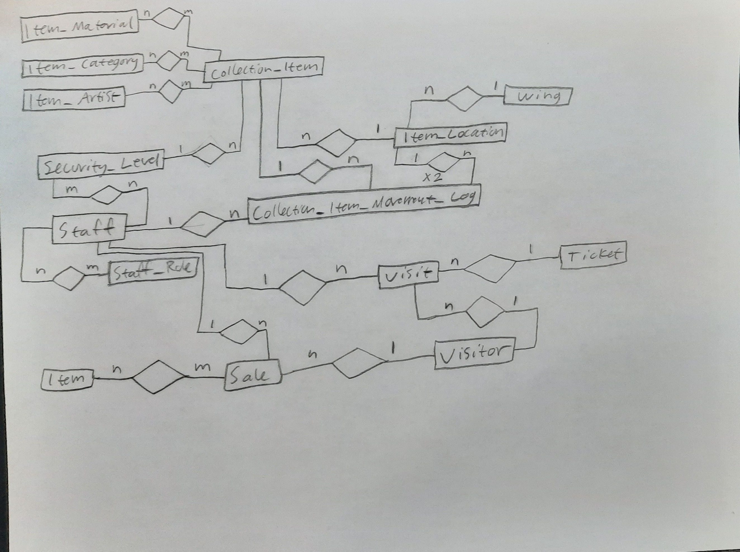
Conceptual Design Diagram

Slide 6
Logical Design
MUSEUM MANAGEMENT SYSTEM

Slide 7
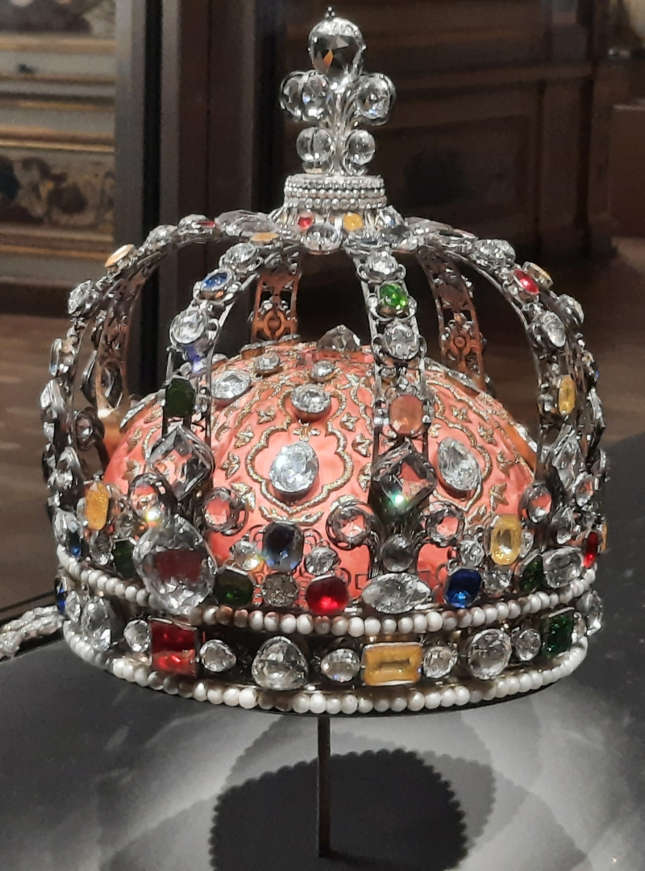
Logical Design: Challenges
The complexity of this system became apparent when designing the logical model. I ended up needing 24 tables to represent my system, which with expanded scope could have easily been doubled.
To the best of my knowledge this is in the 3NF, and I have yet to find any violations of BCNF, although I have not rigorously checked for compliance with BCNF.

Slide 8
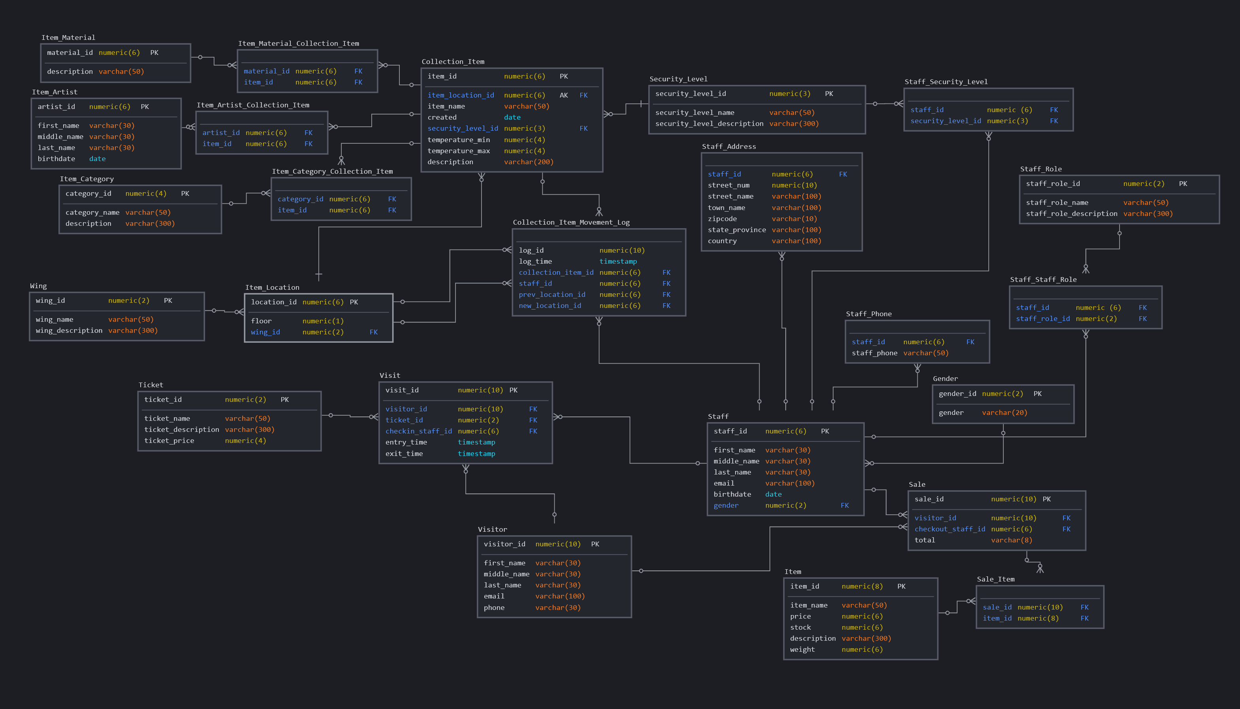
Logical Design
Diagram

Slide 9
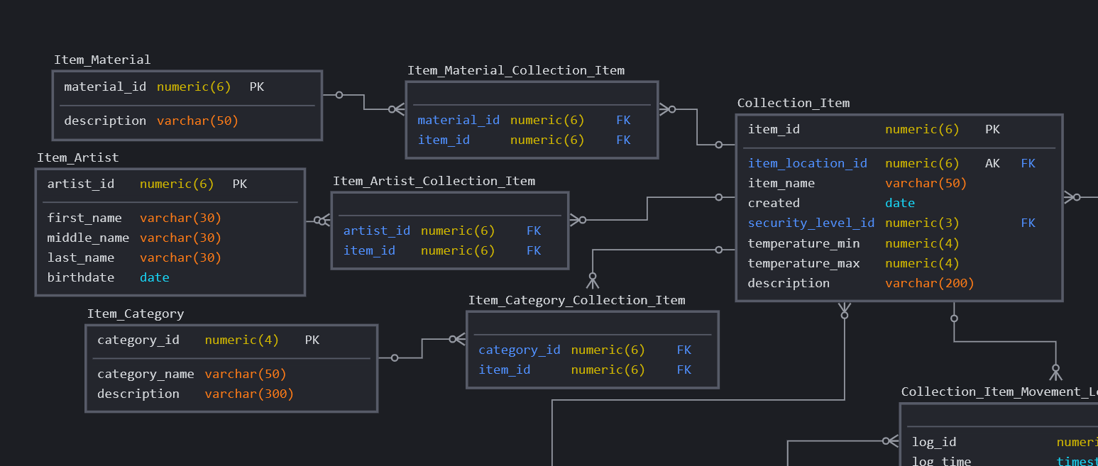

Logical Design
Diagram: Detail I:
Collection_Item

Slide 10
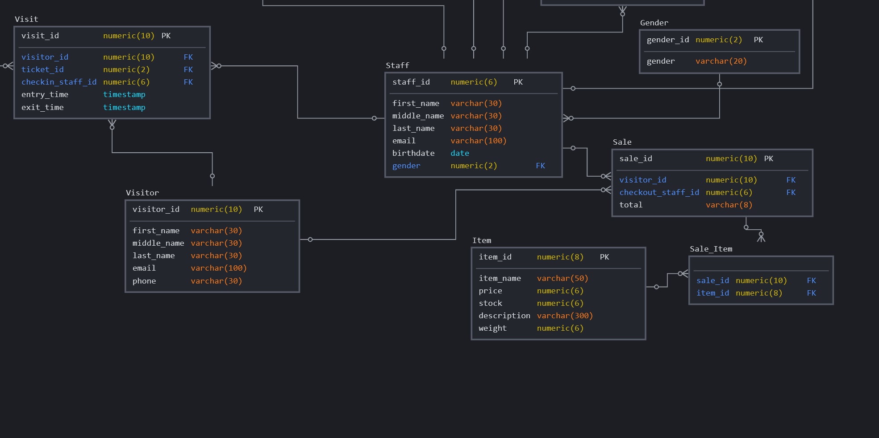
Logical Design
Diagram: Detail II: Staff & VISIT

Slide 11
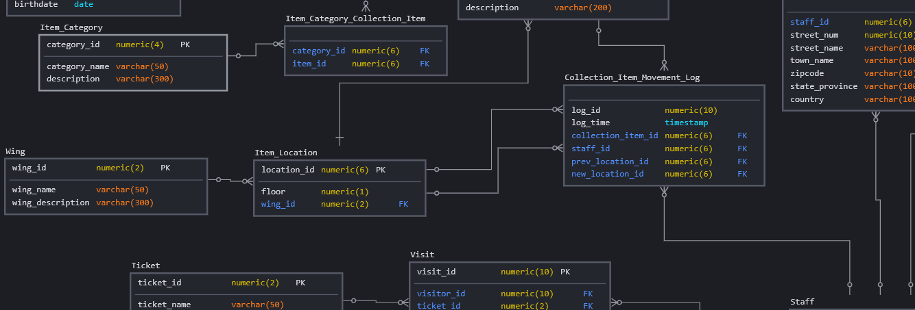
Logical Design
Diagram: Detail III: Movement Log

Slide 12
Physical Design
MUSEUM MANAGEMENT SYSTEM

Slide 13
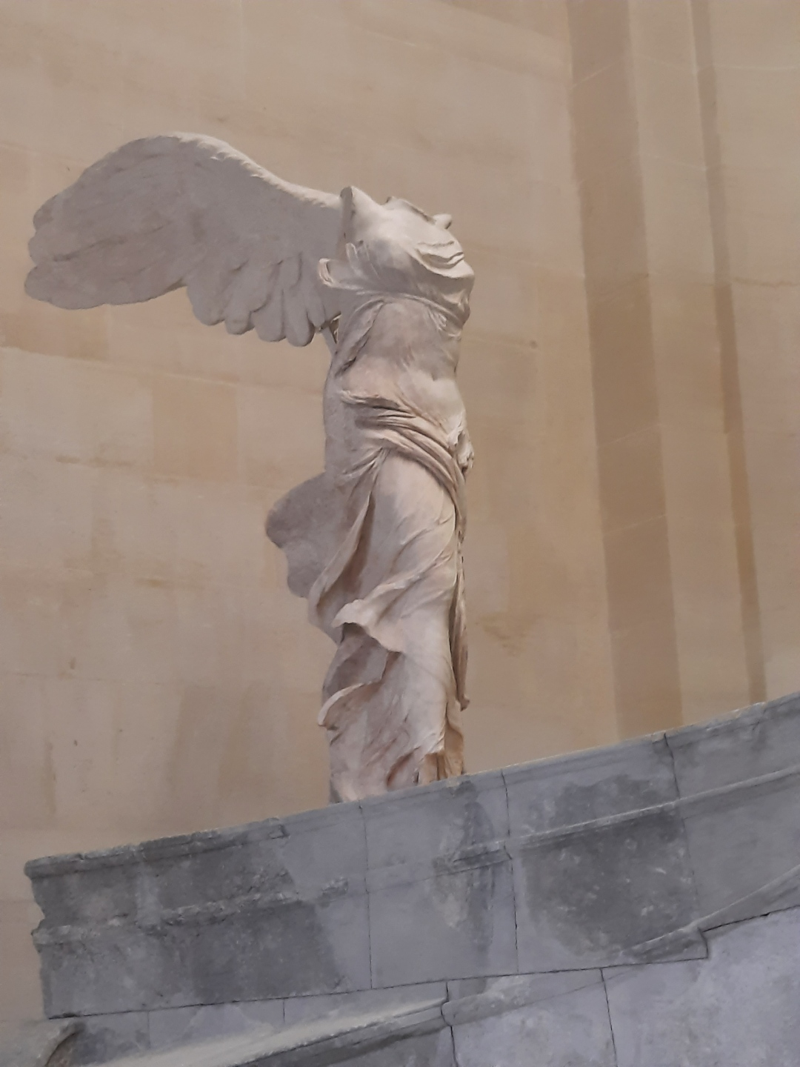
Physical design: Challenges
Scope became an issue again when dealing with the physical design/implementation of the project. My logical design dictates 24 distinct tables. Creating this many tables took a significant amount of time and resulted in a DDL SQL script of 250 lines. DML Insert statements took another 250 lines.
I’ll highlight some of the more interesting DDL & DML SQL in this presentation.

Slide 14
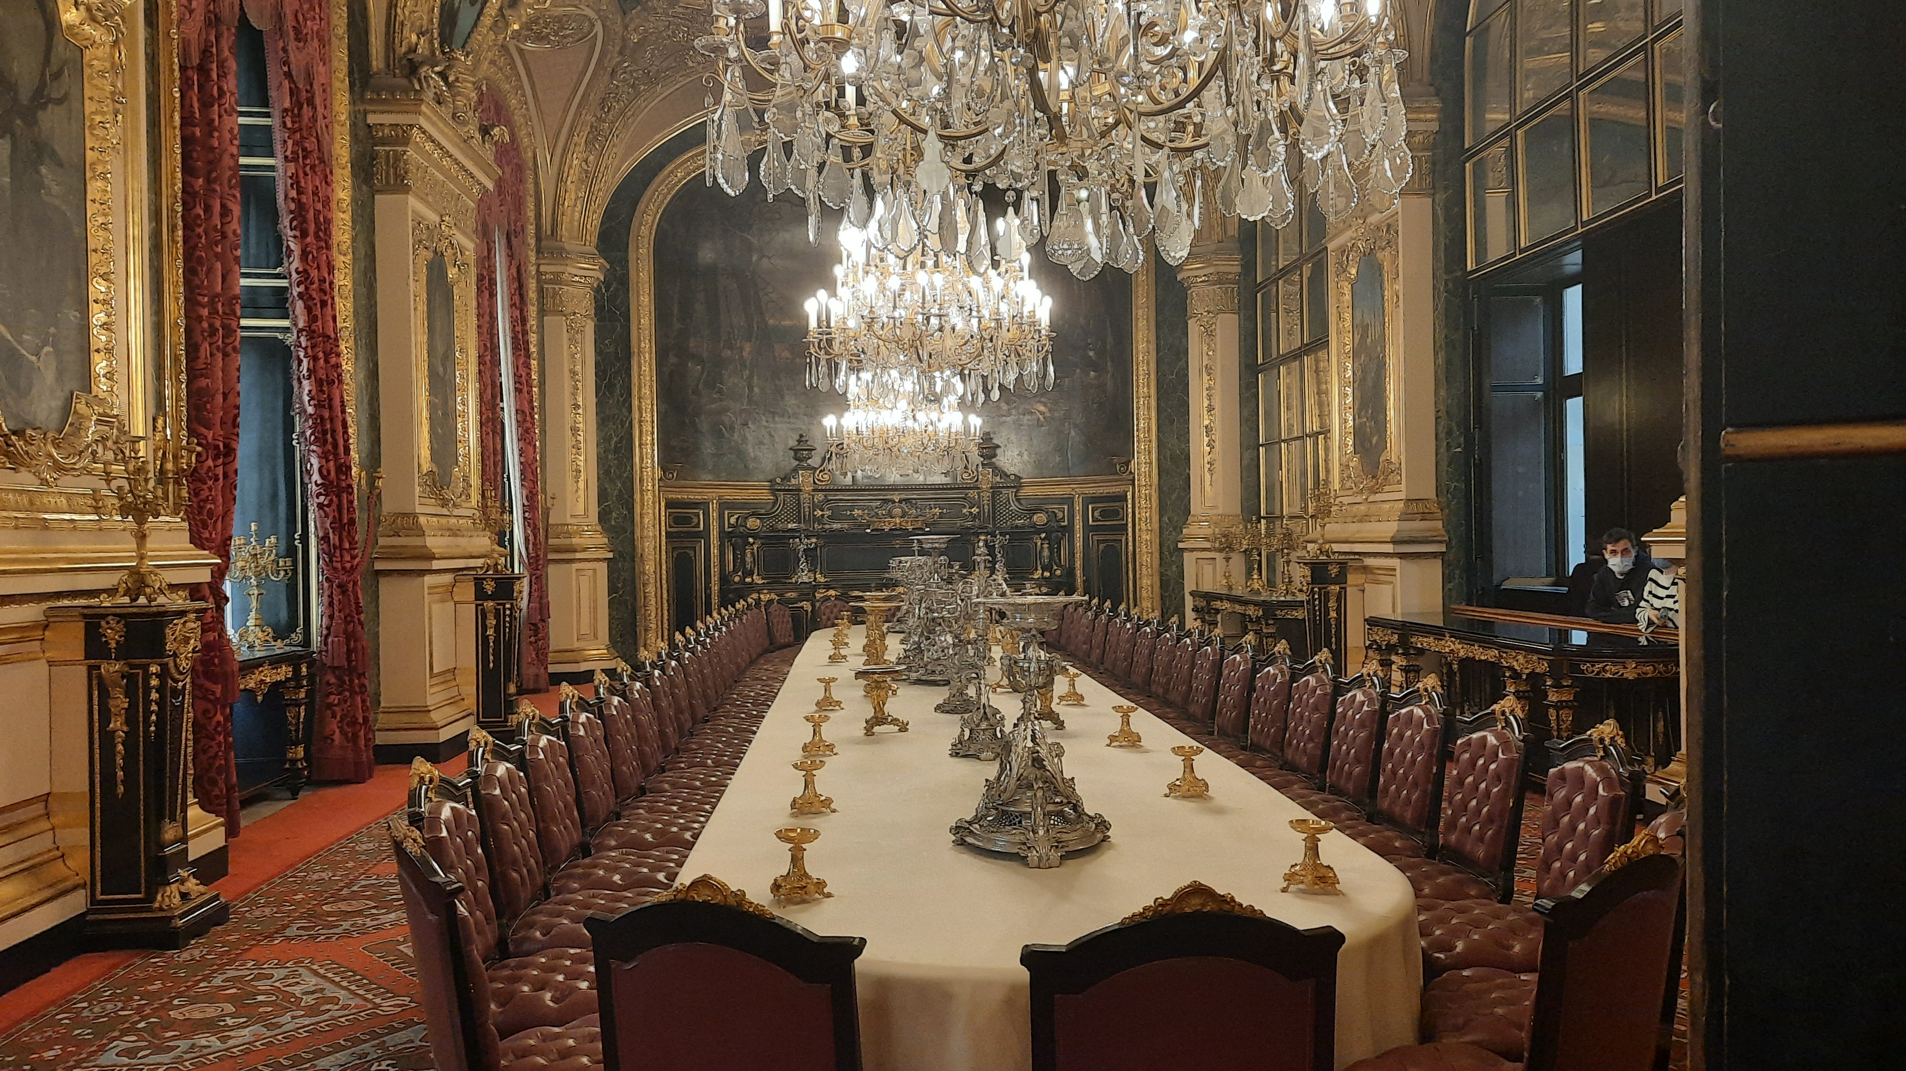
Physical Design: DDL SQL
MUSEUM MANAGEMENT SYSTEM

Slide 15
DDL SQL: Collection_Item & Staff
CREATE TABLE Collection_Item(
item_id NUMERIC(6) PRIMARY KEY,
item_location_id NUMERIC(6) UNIQUE NOT NULL,
item_name VARCHAR(50),
created DATE,
security_level_id NUMERIC(3) NOT NULL,
temperature_min NUMERIC(4),
temperature_max NUMERIC(4),
description VARCHAR(200),
CONSTRAINT collection_item_security_level_id
FOREIGN KEY (security_level_id)
REFERENCES security_level(security_level_id),
CONSTRAINT collection_item_item_location
FOREIGN KEY (item_location_id)
REFERENCES item_location(location_id)
);
CREATE TABLE Staff(
staff_id NUMERIC(6) PRIMARY KEY,
first_name VARCHAR(30),
middle_name VARCHAR(30),
last_name VARCHAR(30),
email VARCHAR(100),
birthdate DATE,
gender NUMERIC(2),
CONSTRAINT staff_gender
FOREIGN KEY (gender)
REFERENCES gender(gender_id)
);

Slide 16
DDL SQL: Movement Log & Staff_Staff_role
CREATE TABLE Collection_Item_Movement_Log(
log_id NUMERIC(10) PRIMARY KEY,
log_time TIMESTAMP,
collection_item_id NUMERIC(6),
staff_id NUMERIC(6),
prev_location_id NUMERIC(6),
new_location_id NUMERIC(6),
CONSTRAINT collection_item_movement_log_collection_item
FOREIGN KEY (collection_item_id)
REFERENCES collection_item(item_id),
CONSTRAINT collection_item_movement_log_staff
FOREIGN KEY (staff_id)
REFERENCES staff(staff_id),
CONSTRAINT collection_item_movement_log_prev_location
FOREIGN KEY (prev_location_id)
REFERENCES item_location(location_id),
CONSTRAINT collection_item_movement_log_new_location
FOREIGN KEY (new_location_id)
REFERENCES item_location(location_id)
);
CREATE TABLE Staff_Staff_Role(
staff_id NUMERIC (6),
staff_role_id NUMERIC(2),
CONSTRAINT staff_staff_role_staff
FOREIGN KEY (staff_id)
REFERENCES staff(staff_id),
CONSTRAINT staff_staff_role_staff_role
FOREIGN KEY (staff_role_id)
REFERENCES staff_role(staff_role_id)
);

Slide 17
Physical Design: DML SQL
MUSEUM MANAGEMENT SYSTEM

Slide 18
DML SQL: Insert Examples
INSERT INTO collection_item VALUES (04, 05, 'Nike of Samothrace', null, 03, 0, 40, 'The Winged Victory of Samothrace, or the Nike of Samothrace,[2] is a votive monument originally found on the island of Samothrace');
--wikipedia https://en.wikipedia.org/wiki/Winged_Victory_of_Samothrace
INSERT INTO collection_item VALUES (05, 06, 'Venus de Milo', null, 03, 10, 30, 'The Venus de Milo is an ancient Greek sculpture from the Hellenistic period, depicting a Greek goddess');
--wikipedia https://en.wikipedia.org/wiki/Venus_de_Milo
INSERT INTO staff VALUES (07, 'Christen', 'Aliyah’, 'Christians', 'christen.christians@zacksmuseum.com', DATE '1998-02-24', 02);
INSERT INTO staff VALUES (08, 'Mia', 'Euphrasia', 'O Corra', 'mia.e.ocorra@zacksmuseum.com', DATE '2000-01-26', 02);
INSERT INTO staff VALUES (09, 'Salome', 'Sita', 'Burton', 'salome.burton@zacksmuseum.com', DATE '1983-09-23', 02);
INSERT INTO visitor VALUES (03, 'Chedomir', 'Rayhana', 'Morales', 'chedomir.morales@emailprovider.com', 18379903045);
INSERT INTO visitor VALUES (04, 'Félicienne', 'Kenneth', 'Magro', 'fkm@emailprovider.com', 13982873243);
INSERT INTO visitor VALUES (05, 'Albina', 'Golyat', 'MacShuibhne', 'albinagms@emailprovider.com', 19283745623);
INSERT INTO item VALUES (01, 'Samothrace statue 10in', 195, 28, '10 inch resin statue replica of the Nike of Samothrace', 10);
INSERT INTO item VALUES (02, 'Venus statue 10in', 145, 14, '10 inch resin statue replica of the Venus de Milo', 8);
INSERT INTO item VALUES (03, 'Mona Lisa Pen', 9, 300, 'Pen with Mona Lisa design', 0.2);
INSERT INTO item VALUES (04, 'Mona Lisa Keychain', 14, 200, 'Keychain with Mona Lisa design', 0.3);
INSERT INTO item VALUES (05, 'Sculpture Kit', 45, 30, 'Clay sculpture kit', 2);
INSERT INTO collection_item_movement_log VALUES (02, TIMESTAMP '2021-12-05 5:30:00 -05:00', 02, 05, 02, 03);
INSERT INTO collection_item_movement_log VALUES (03, TIMESTAMP '2021-12-05 5:45:00 -05:00', 01, 05, 01, 02);
INSERT INTO staff_address VALUES (09, 95, 'Mccarter Way', 'Indialantic', 56328, 'Kansas', 'United States of America');
INSERT INTO staff_address VALUES (10, 23, 'Belmont St', 'Warren', 35789, 'West Virginia', 'United States of America’);

Slide 19
DML SQL: SELECT Examples I
-- All artworks with artist name, even if there's no linked artist
SELECT collection_item.item_name, item_artist.first_name, item_artist.last_name, collection_item.description FROM collection_item LEFT JOIN item_artist_collection_item
ON collection_item.item_id = item_artist_collection_item.item_id
LEFT JOIN item_artist
ON item_artist.artist_id = item_artist_collection_item.artist_id;
ITEM_NAME | FIRST_NAME | LAST_NAME | DESCRIPTION
Mona Lisa | Leonardo | da Vinci | Half-Length portrait painting
Virgin of the Rocks | Leonardo | da Vinci | Paris version of The Virgin of …
David | Michelangelo | Buonarotti | David is a 5.17-metre marble …
Nike of Samothrace | - | - | The Winged Victory of …
Venus de Milo | - | - | The Venus de Milo is an ancient …

Slide 20
DML SQL: SELECT Examples II
-- Staff members info with description of role
SELECT staff.first_name, staff.last_name, staff.email, staff_role.staff_role_description
FROM staff LEFT JOIN staff_staff_role
ON staff.staff_id = staff_staff_role.staff_id
LEFT JOIN staff_role
ON staff_staff_role.staff_role_id = staff_role.staff_role_id;
FIRST_NAME | LAST_NAME | EMAIL | STAFF_ROLE_DESCRIPTION
Janne | O Cuirc | janne.g.ocuirc@zacksmuseum.com | Directly responsible for collections
Hosee | Hoedemaekers | hosee.hoedemaekers@zacksmusem.com | Preservation of historical items
Henry | Tumicelli | henry.tumicelli@zacksmuseum.com | Oversees specific collections
Christen | Christians | christen.christians@zacksmuseum.com | Oversees specific collections
… | … | … | …

Slide 21
DML SQL: SELECT Examples III
-- All visitors who have purchased items
SELECT UNIQUE visitor.visitor_id, visitor.first_name, visitor.last_name, visitor.email
FROM visitor RIGHT JOIN sale
ON visitor.visitor_id = sale.visitor_id;
VISITOR_ID | FIRST_NAME | LAST_NAME | EMAIL
1 | Aisha | Giese | aisha.tamas@emailprovider.com
5 | Albina | MacShuibhne | albinagms@emailprovider.com
2 | Mathilde | Hinrichs | mathildeh@emailprovider.com

Slide 22
THANK YOU

